Slide 1
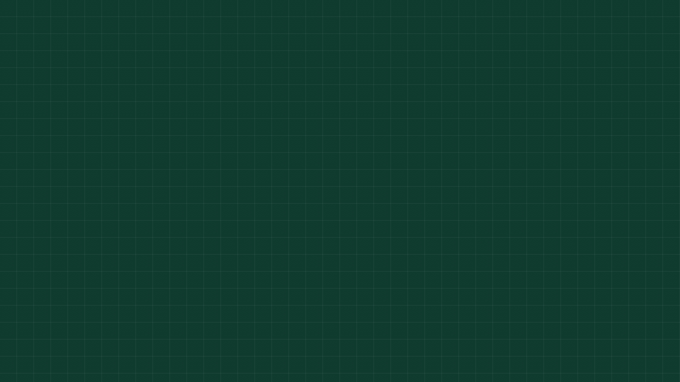


Knapsack Problem in C, Made Easy
Dynamic Programming Explained Simply
Name: Bhavya Agrawal
PRN: 25070521016
Notes:
1

Slide 2



What is the Knapsack Problem?
  A bag has limited capacity.
  Each item has a weight and a value.
  Pick items for maximum total value without exceeding capacity.
  0/1 knapsack: each item is taken once or left behind.
Examples: packing a bag; choosing projects with a limited budget.
02
Notes:
2

Slide 3
Which items maximize value?
Item | Weight | Value
1 | 1 | 10
2 | 3 | 40
3 | 4 | 50
4 | 5 | 70
W = 8
Capacity W = 8
Question: which items give the maximum value?
03
Notes:
3

Slide 4
Dynamic programming avoids repeated work
1
2
3
Brute force
Build smaller answers
Reuse
Brute force checks 2^N combinations.
It reuses results instead of recalculating them.
Dynamic programming solves smaller subproblems first.
dp[i][w] = best value using the first i items with capacity w.
04
Notes:
4

Slide 5





For each item, skip it or take it
Compare
Choose max of Skip and Take
Take
val[i-1] + dp[i-1][w - wt[i-1]]
  Skip: dp[i-1][w]
  Take: val[i-1] + dp[i-1][w - wt[i-1]]
  Pick the larger value.
  If the item is heavier than w, it cannot be taken.
Skip
Use dp[i-1][w]
Current Item
Consider item i and capacity w
05
Notes:
5

Slide 6
C Code, Part 1: Setup
#include <stdio.h>
#define N 4
#define W 8
int max(int a, int b) { return a > b ? a : b; }
int main() {
int wt[N] = {1, 3, 4, 5};
int val[N] = {10, 40, 50, 70};
int dp[N + 1][W + 1];
  stdio.h: enables printf.
  N and W: item count and bag capacity.
  wt, val: the input arrays.
  dp: stores the best answers.
06
Notes:
6

Slide 7
Base case: no items or zero capacity.
C Code, Part 2: The Loops
Fits: compare take vs skip.
for (int i = 0; i <= N; i++) {
for (int w = 0; w <= W; w++) {
if (i == 0 || w == 0)
dp[i][w] = 0;
else if (wt[i - 1] <= w)
dp[i][w] = max(val[i - 1] + dp[i - 1][w - wt[i - 1]],
dp[i - 1][w]);
else
dp[i][w] = dp[i - 1][w];
}
}
printf("Maximum value = %d\\n", dp[N][W]);
return 0;
}
Does not fit: carry the previous best.
07
Notes:
7

Slide 8
The answer is 110
i\w | 0 |  |  | 1 | 2 | 3 | 4 | 5 | 6 | 7 | 8
0 | 0 |  |  | 0 | 0 | 0 | 0 | 0 | 0 | 0 | 0
1 | 0 |  |  | 10 | 10 | 10 | 10 | 10 | 10 | 10 | 10
2 | 0 |  |  | 10 | 10 | 40 | 50 | 50 | 50 | 50 | 50
3 | 0 |  |  | 10 | 10 | 40 | 50 | 50 | 60 | 90 | 90
4 | 0 |  |  | 10 | 10 | 40 | 50 | 70 | 80 | 90 | 110
Terminal output: Maximum value = 110
  Best choice: item with weight 3 + item with weight 5.
  Total weight: 8
  Total value: 40 + 70 = 110
Highlight answer cell dp[4][8].
08
Notes:
8

Slide 9
Complexity and real-world uses
Where it helps
O(N x W)
O(N x W)
Uses: budgeting, cargo loading, resource allocation, investment selection.
Variants: fractional knapsack and unbounded knapsack.
Time
Space
Time: O(N x W)
Space: O(N x W)
09
Notes:
9

Slide 10
01
Choose to take or skip each item.
Thank You!
02
Build a dp table.
03
The answer is in the bottom-right cell.
10
Notes:
10

